Slide 1



Exhaustive Analysis of Indian Agricultural Sector using Power BI
Student Name : Rajiv .R
College Name : Nehru Institute of Engineering and Technology
AICTE Student ID : STU6455e22a6bf3e1683350058

Slide 2

Learning Objectives
Understand and analyze historical agricultural data trends.
Identify key contributors to crop production and economic value.
Develop and interpret Key performance indicators (KPIs).
Analyse regional variations.
Utilize Data mining techniques.
Build Predictive Models based on historical data.
Utilize Power BI for interactive data visualization and analysis.
Gain a deep understanding of the Indian agriculture sector.
GOAL
Source :
www.freepik.com/

Slide 3
Tools and Technology used
Power BI – A powerful business intelligence tool by Microsoft for data visualization, analysis, and reporting through interactive dashboards. Power BI offers both a desktop application for detailed analysis and a cloud-based service for sharing and collaboration.
Microsoft Excel – Used for preliminary data cleaning, transformation, and analysis before importing into Power BI for visualization.
DAX (Data Analysis Expressions) – A formula language in Power BI used for performing advanced calculations and aggregations on data models.
CSV Data Format – A widely used file format for storing structured data, making it easy to import and manipulate large datasets.

Slide 4
Methodology
Data Collection & Cleaning – Gathered 19 years of historical agricultural data from accessed from various government sources and agricultural research organizations. Cleaned and structured the data to remove inconsistencies, missing values, and errors.
Data Preprocessing – Sorted, filtered, and organized data into relevant categories such as crops, states, and seasons. Applied necessary transformations to enhance readability and usability.
DAX Implementation – Data Analysis Expressions (DAX) helps to perform calculations like total production, seasonal trends, and yield per hectare.
Visualization Design – Created interactive dashboards with charts, graphs, and maps to illustrate key insights.
Analysis & Interpretation – Examined historical trends, production variations, and regional disparities. Derived meaningful insights to inform agricultural policies and strategies.

Slide 5
Problem Statement:
Develop an interactive Power BI dashboard to provide a comprehensive analysis of the Indian agriculture sector, leveraging 19 years of historical data from 33 states, 646 districts, and across five seasons for 122 unique crops.
The data for this project is based on the Indian Agriculture dataset, which can be accessed from various government sources and agricultural research organizations.
Link : apy_1.csv

Slide 6
Solution:
Total Crop Production – 45.17 billion tons over 19 years
Average Production per Year – 611.81K tons
Top 3 Crops by Production – Coconut (42 billion tons) ,Sugarcane and Wheat.
Top 3 States in Production – Kerala (33.14 bn tons) ,Tamil Nadu (4.05bn tons) and Andhra Pradesh (3.6bn tons).
Top 3 Producing Districts – Kozhikode (6.01bn tons), Malappuram (4.38bn tons), Thrissur (3.68bn tons).
Seasonal Variations – Kharif season dominates (93.73% production), followed by minor contributions from Winter, Rabi, and others.
Yearly Production Trends – Highest production observed in 2019 (5.38bn tons).
Regional Disparities – Uneven production across states and districts.
Growth Potential – Policy improvements & climate resilience strategies can enhance productivity.

Slide 7
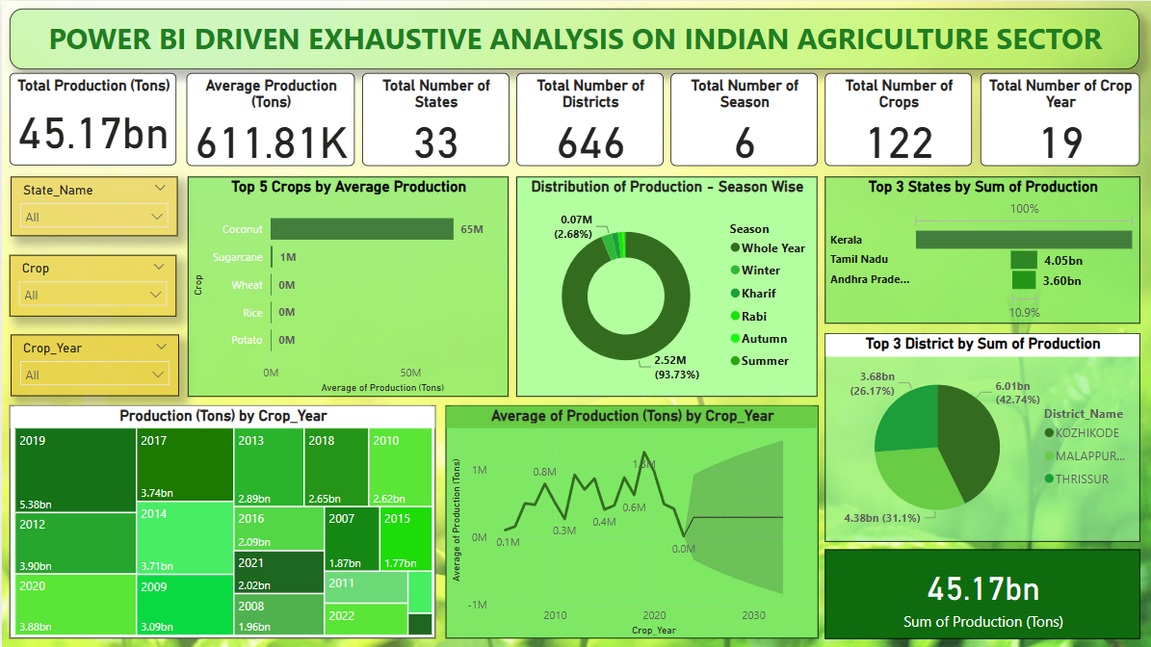
Screenshot of Output:

Slide 8
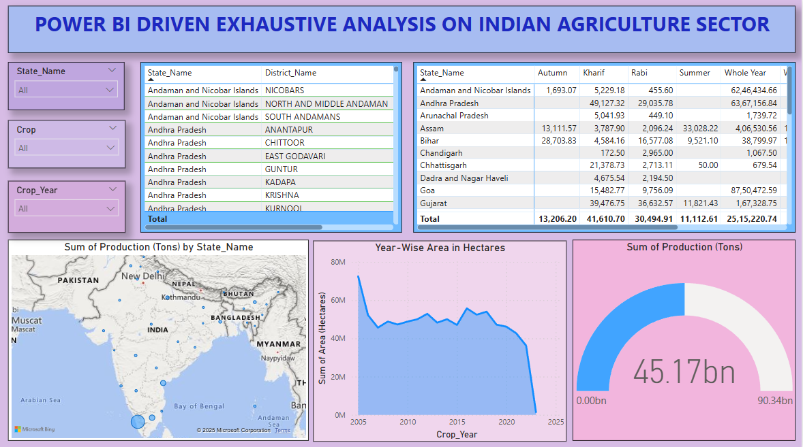
Screenshot of Output:

Slide 9
Conclusion:
As the conclusion, Power BI-driven analysis of the Indian agriculture sector provides valuable insights into the trends, patterns, and challenges faced by the industry. By leveraging 19 years of historical data, the project has successfully identified key crops, regions, and seasons that contribute significantly to the overall production. The analysis has also revealed regional disparities, the impact of climate factors, and the potential for growth through diversification and improved agricultural practices.
The interactive dashboard developed in Power BI empowers users to explore and visualize the data in a user-friendly manner, enabling informed decision-making and policy development. The findings from this analysis can be utilized by policymakers, researchers, and agricultural stakeholders to address the challenges faced by the sector and promote sustainable and equitable agricultural development in India

Slide 10
THANK YOU!!!

